Slide 1

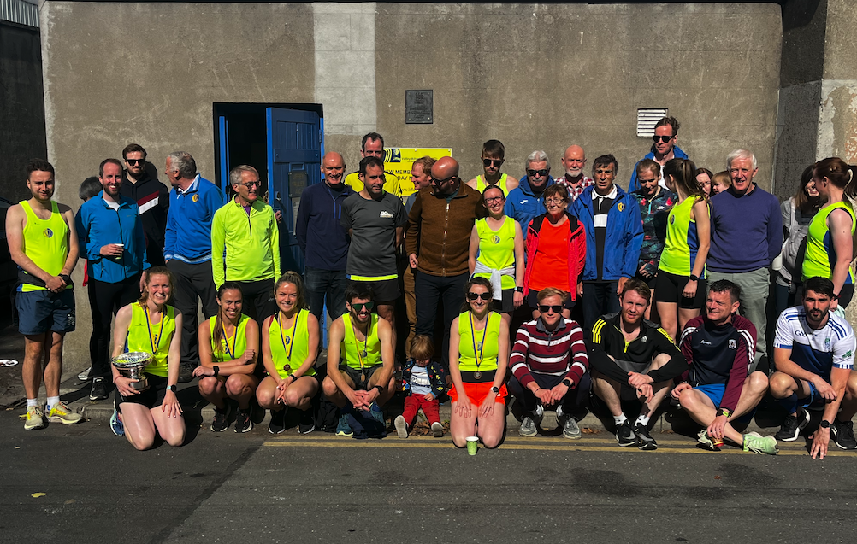
Records Secretary Report
2022/2023 Season

Slide 2
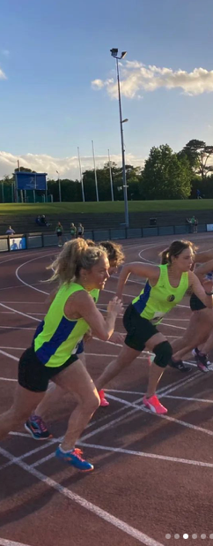
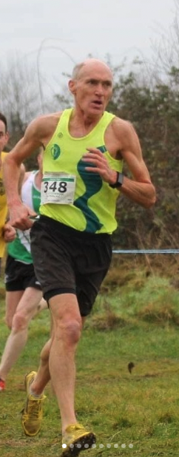
Content
Cross Country Season
Track Season
Road Races
LVAC Championships & Trophies

Slide 3
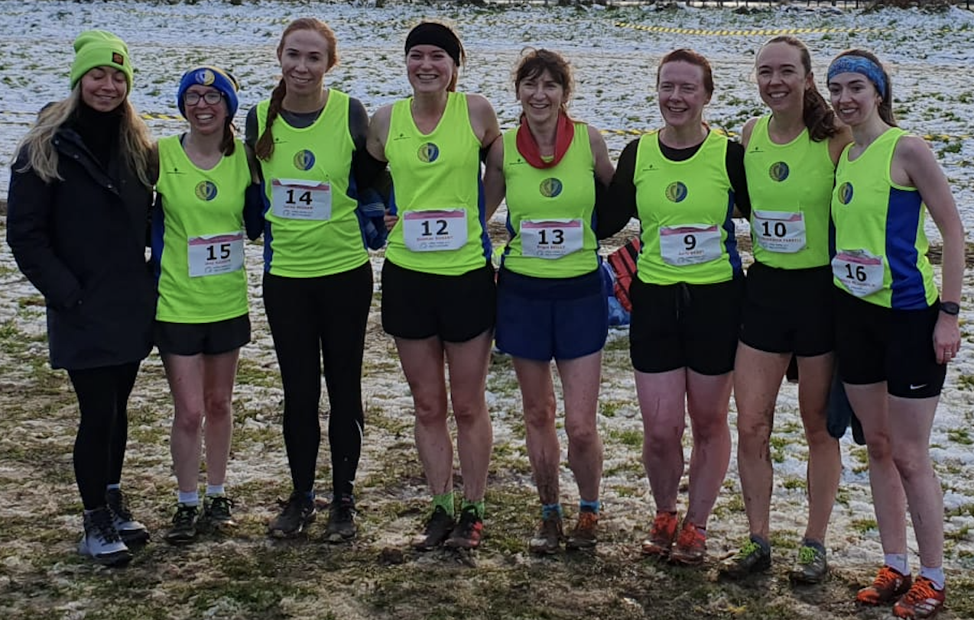
CROSS COUNTRY 2022/2023 Season Review
2022/2023 Season Review

Slide 4
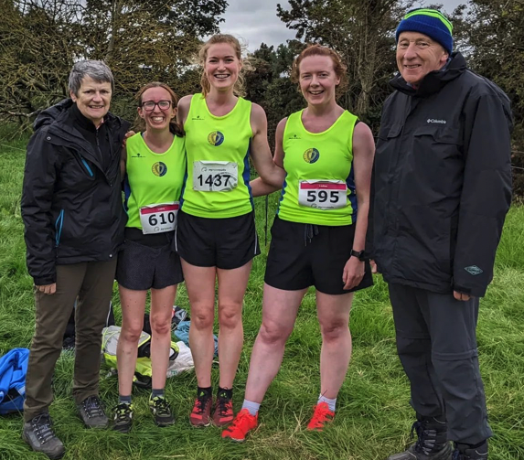
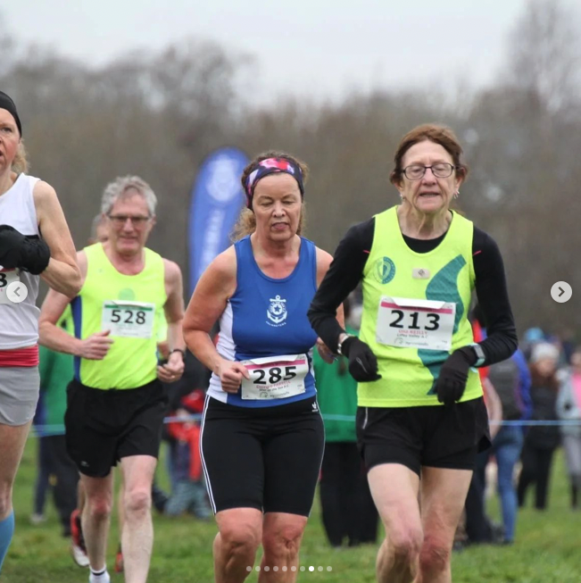
XC SUMMARY
38 Athletes took part across 10 championship races
111 athletes entered
Women 36
Men 40
Masters 35
Women’s Team Medals 🥈🥈
Masters Individual Medals 🥇🥈🥉🥇🥇🥇🥈🥉🥇🥉🥉🥉
10+ Tents Assembled 🙏👏 🙏👏 🙏👏 🙏👏 🙏👏

Slide 5
CROSS COUNTRY races
October
Dublin Novice
AAI Autumn Open
November
Dublin Senior
December
Dublin Inter
National Novice
LVAC Cake Race
Dublin Masters
Leinster Inter
Leinster Masters
LVAC 5k XC
January
February
National Inter
National Masters
LVAC XC Championship
Leinster Novice

Slide 6
Cross country participation
2022/2023 Season Review
Notes:
ID=dd91c577-f997-49fe-a5eb-611d59b20eb8 Recipe=crop Type=Foreground Variant=0 FamilyID=ClassicFrameGoudy_Zero

Slide 7



WOMEN TEAM POSITIONS
 | Novice | Intermediate | Senior
 | 5th | 🥈 | 5th
 | 12th | 🥈 | DNE
 | DNE | 6th | DNE
2022/2023 Season Review

Slide 8
Men TEAM POSITIONS
 | Novice | Intermediate | Senior | Masters (M35) | Masters (M50)
 | 5th | 4th | 5th | 15th | 6th
 | 12th | 4th | DNE | 6th | 4th
 | DNE | 5th | DNE | 12th | DNE

Slide 9

Individual Master MEDALS
🥇Tom O’Connor M60 🥈Una Reilly F70 🥉Arnaud Benjacar M50 | 🥇Peter Arthur M35 🥈Tom O’Connor M60 🥉Pat Collins M70 🥇Peter Arthur M35 County 🥇Arnaud Benjacar M50 County | 🥇Pat Collins M75 🥉Una Reilly F70 🥉Peter Arthur M35 | 🥈Tom O’Connor M60 (Team)
2022/2023 Season Review

Slide 10
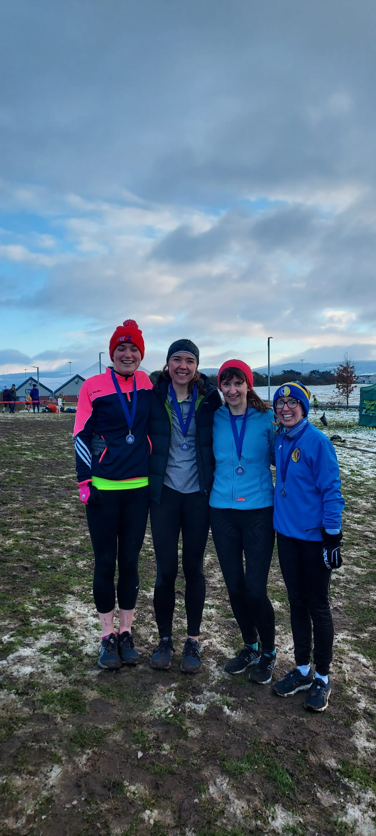
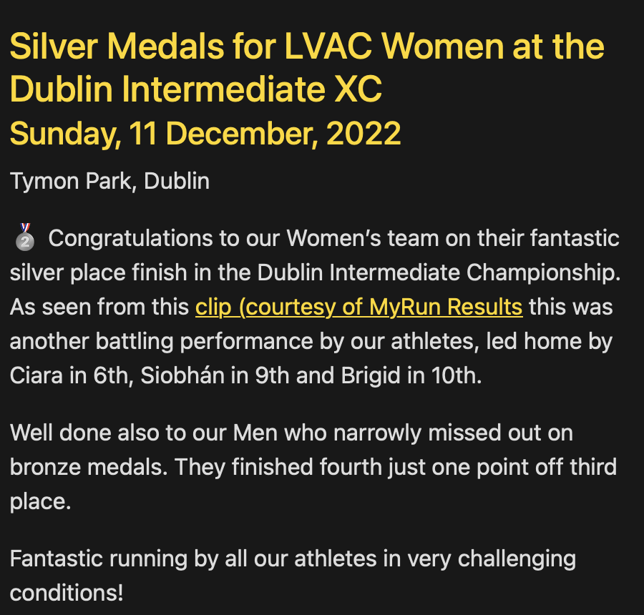

Slide 11
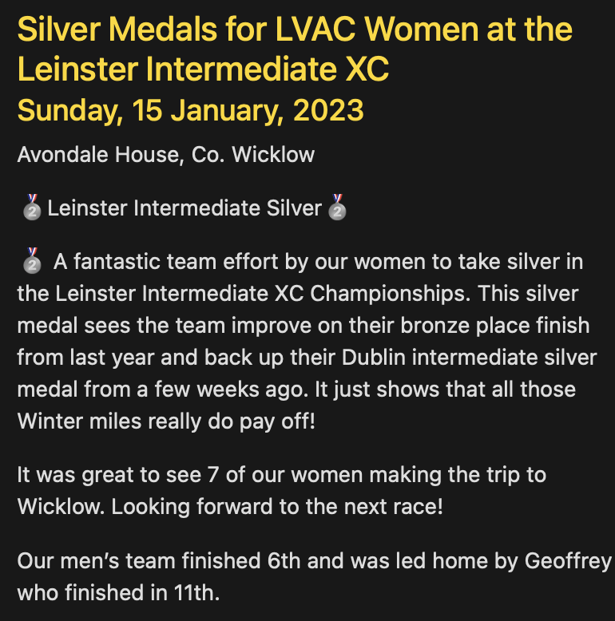
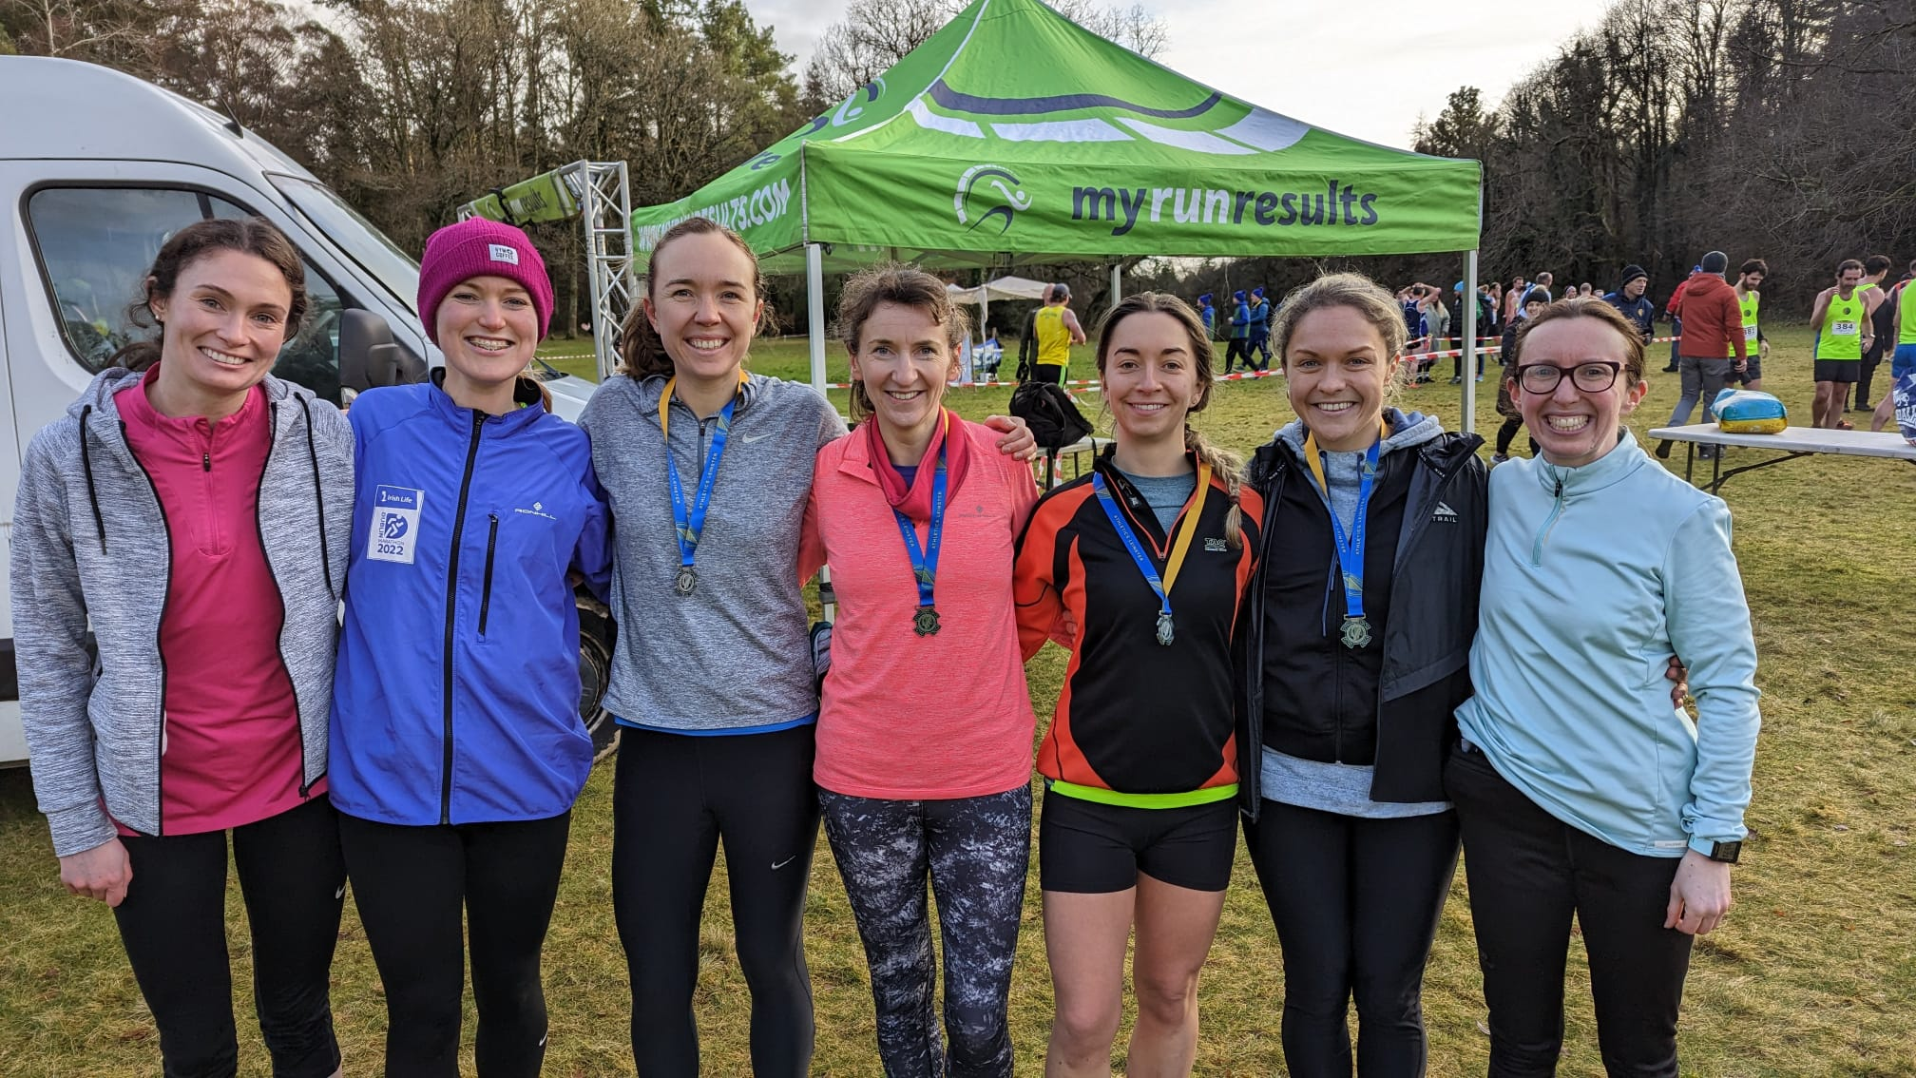

Slide 12
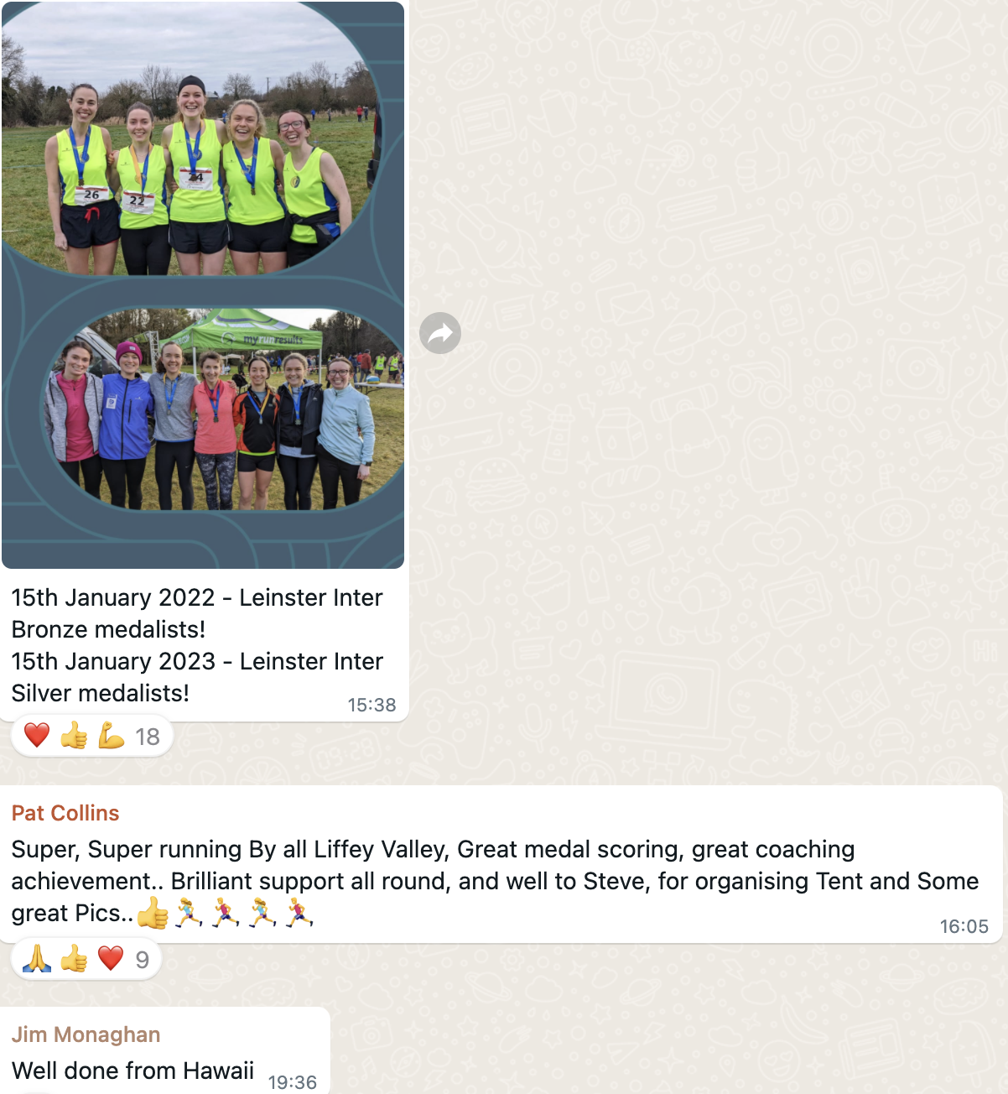

Slide 13
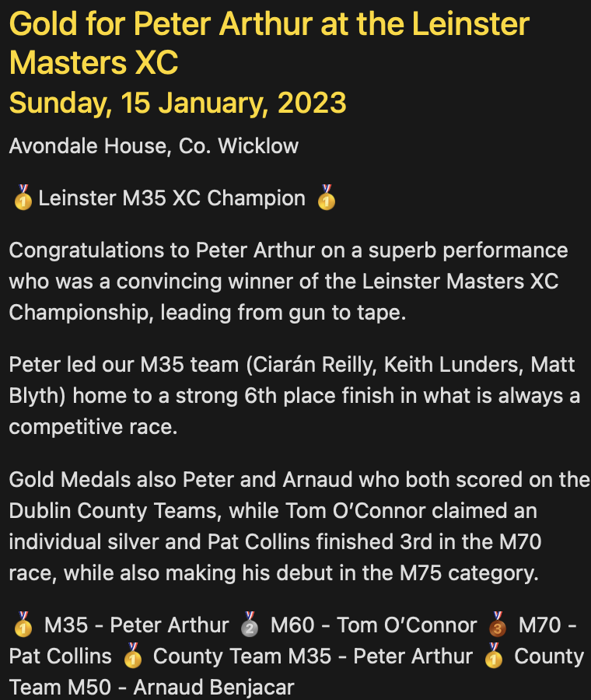
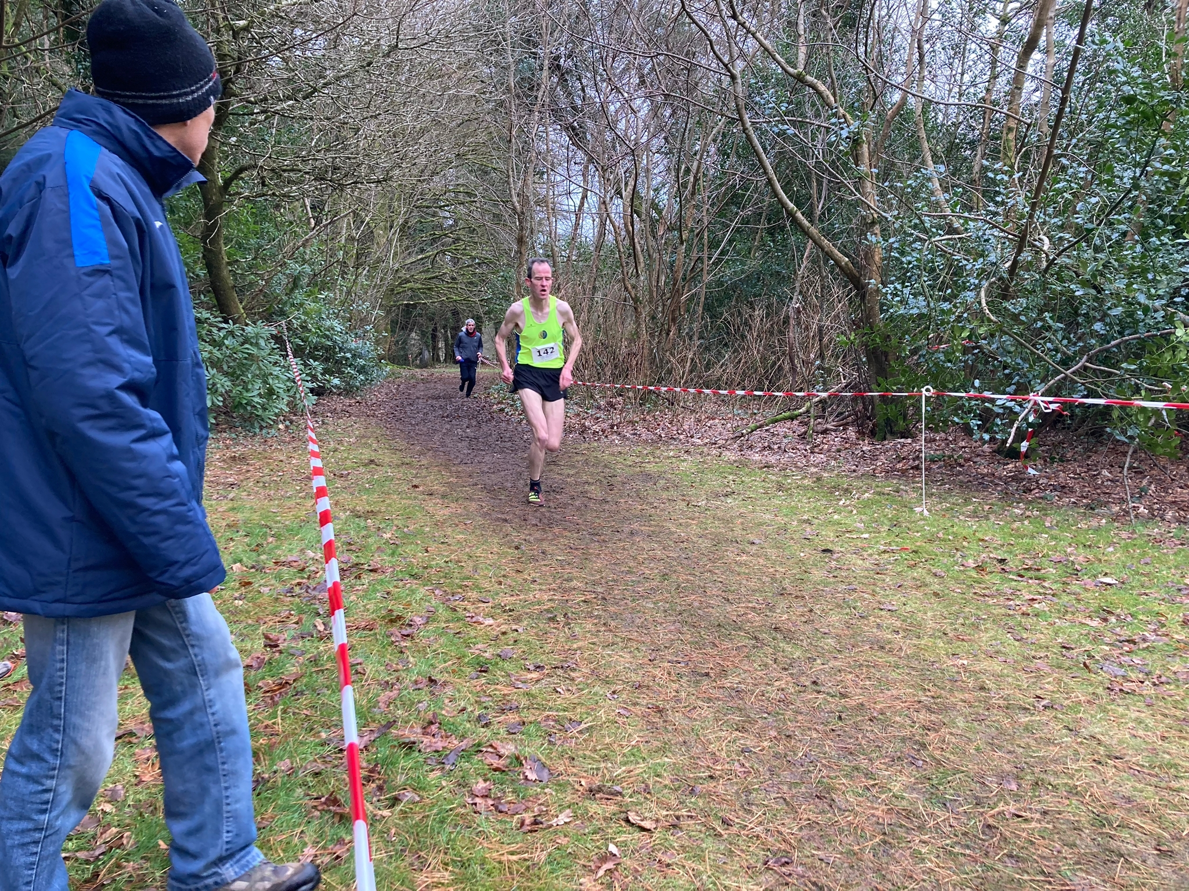

Slide 14
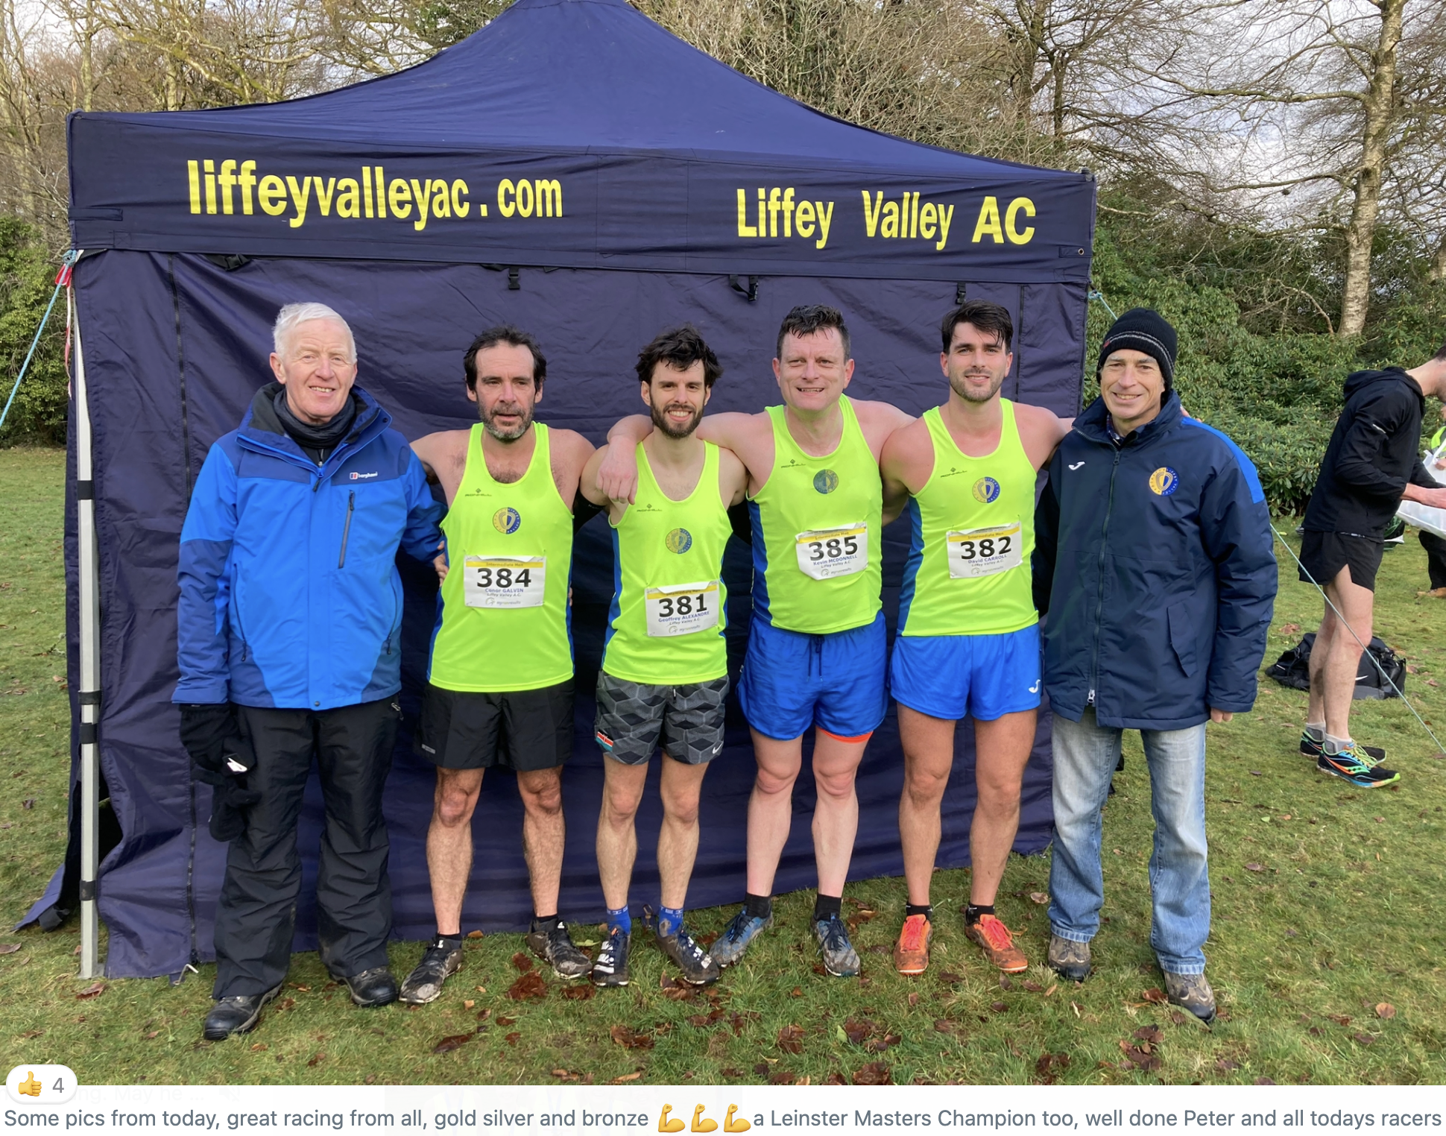

Slide 15
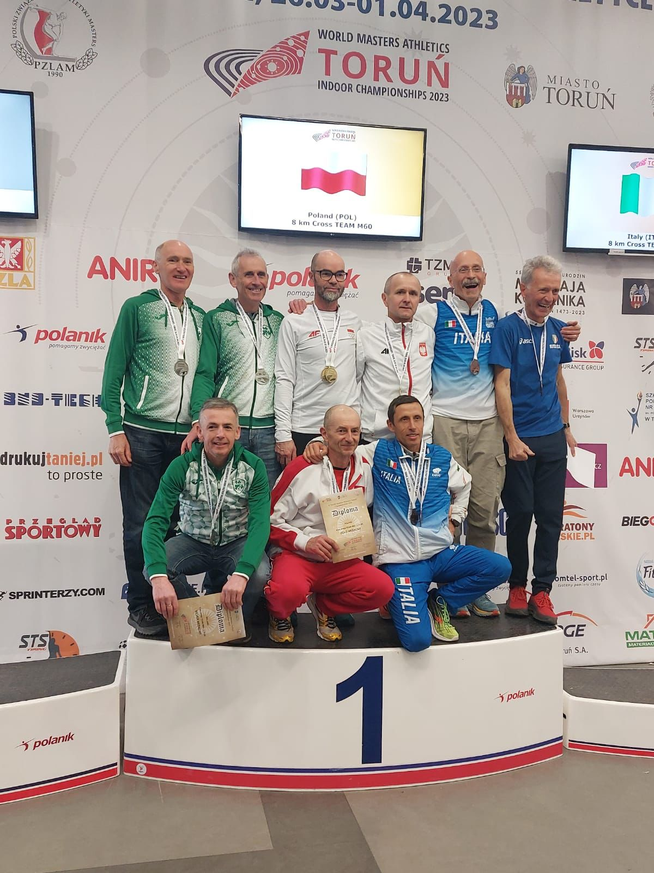
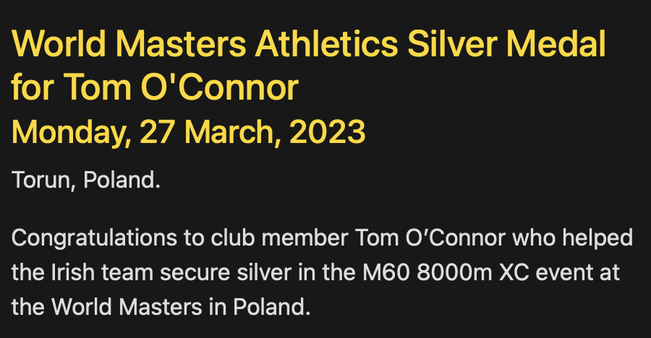

Slide 16
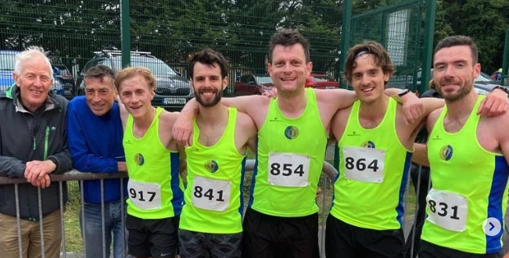
Track
2021/2022 Season Review

Slide 17
track RACES
April
29th Dublin Graded 1
May
10th Dublin Graded 2
24th Dublin Graded 3
29th Leinster Track & Field Championships
June
3rd Dublin Graded 4
21st Dublin Graded 5
28th LVAC 800m
5th Dublin Graded 6
12th LVAC 1500m
12th LVAC 3000m
19th Dublin Graded 7
30th National Senior
July
August
2nd Dublin Graded 8
February
5th National Indoor Masters
🥉Arnaud Benjacar 1500m

Slide 18
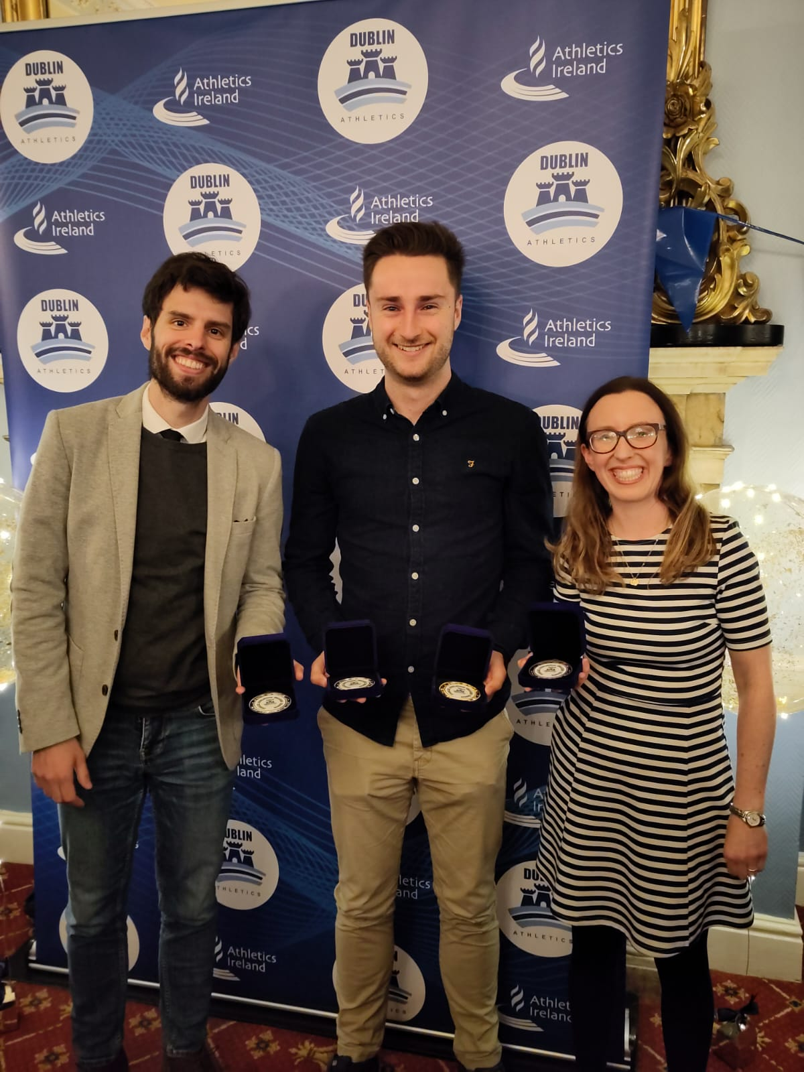
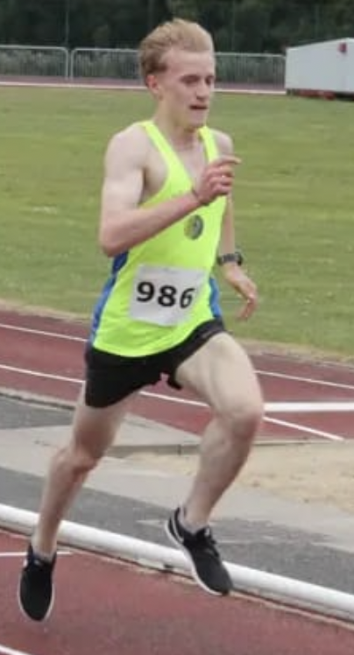
DUBLIN GRADED track SUMMARY
Participation across 8 meets
Women 6
Men 20
Top 3 Finishes from 88 starts
1st 6
2nd 9
3rd 14
Top 3 Grand Prix Grade Winners:
Orla
Sergei 🥇 Grade C
Conor 🥈 Grade C
Geoffrey

Slide 19
Track participation
2021/2022 Season Review
Notes:
ID=dd91c577-f997-49fe-a5eb-611d59b20eb8 Recipe=crop Type=Foreground Variant=0 FamilyID=ClassicFrameGoudy_Zero

Slide 20
Dublin graded races
2021/2022 Season Review
Notes:
ID=dd91c577-f997-49fe-a5eb-611d59b20eb8 Recipe=crop Type=Foreground Variant=0 FamilyID=ClassicFrameGoudy_Zero

Slide 21
Dublin graded APPEARANCES
2021/2022 Season Review
Notes:
ID=dd91c577-f997-49fe-a5eb-611d59b20eb8 Recipe=crop Type=Foreground Variant=0 FamilyID=ClassicFrameGoudy_Zero

Slide 22
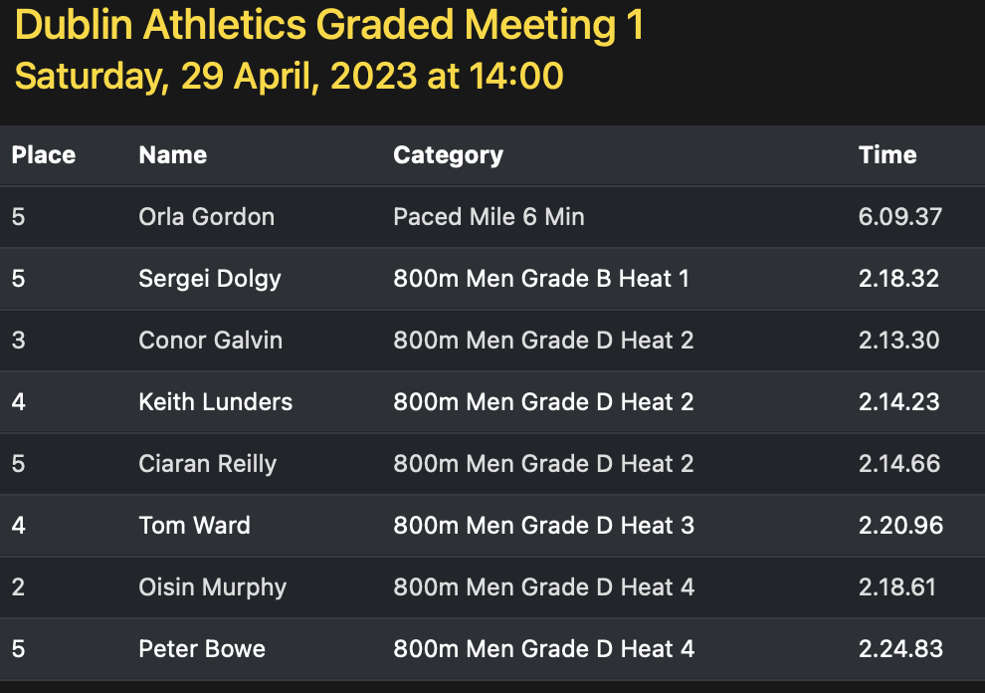

Slide 23
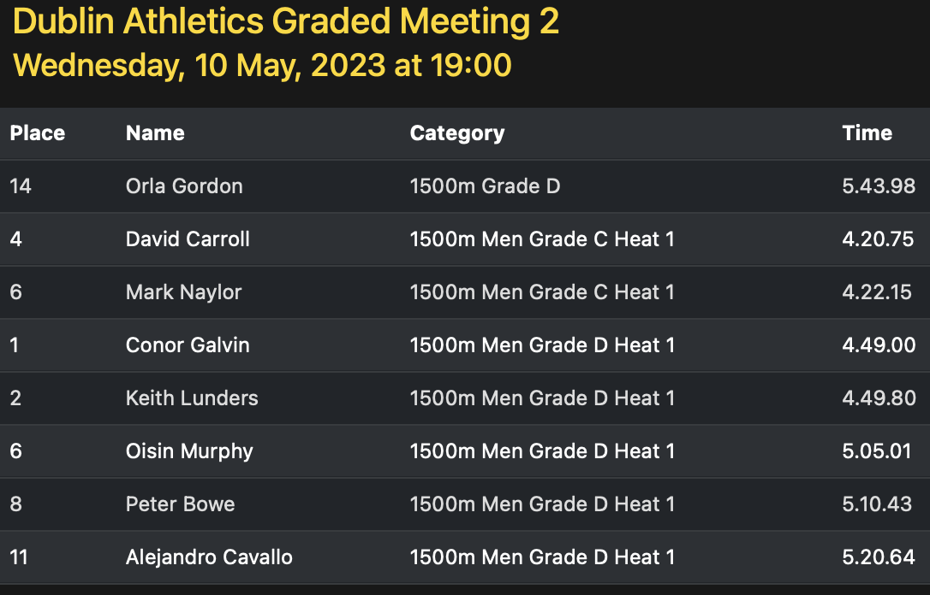

Slide 24
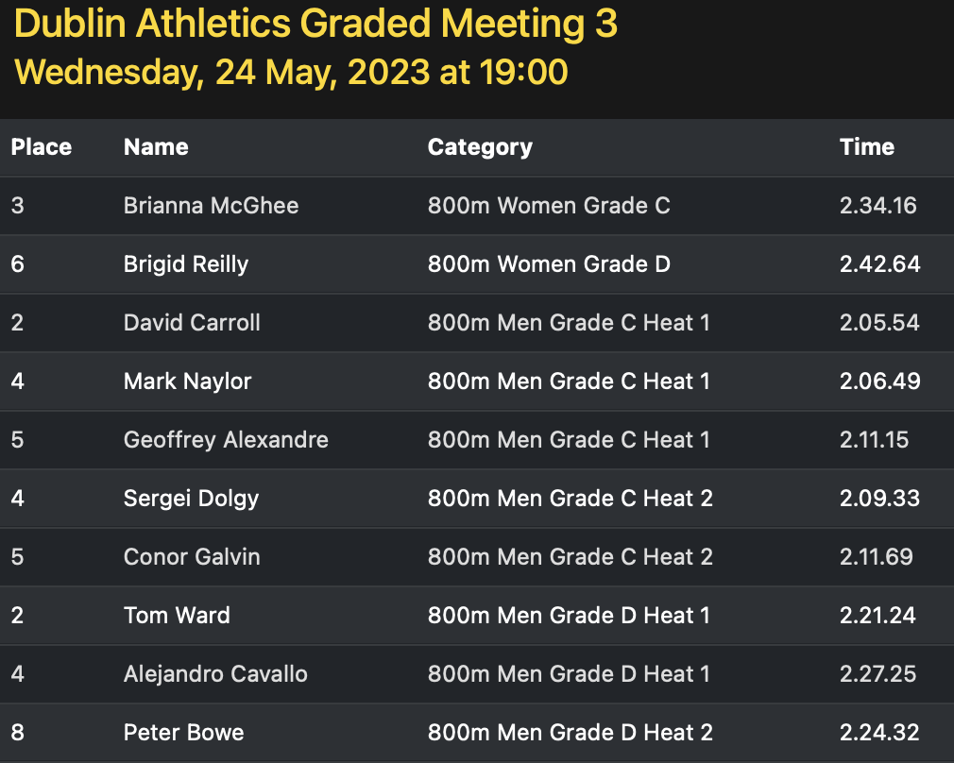

Slide 25
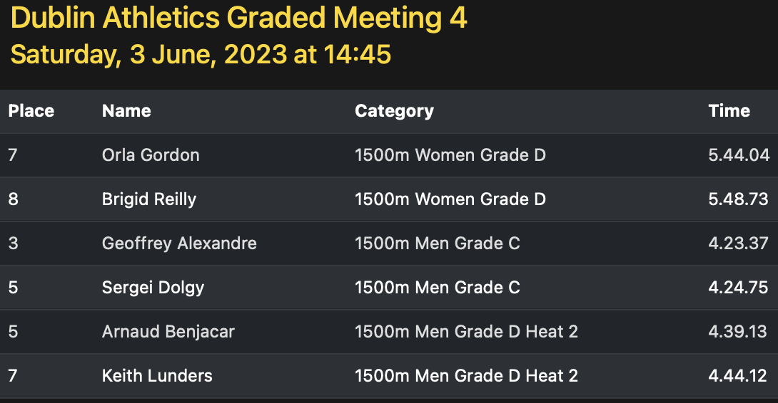

Slide 26
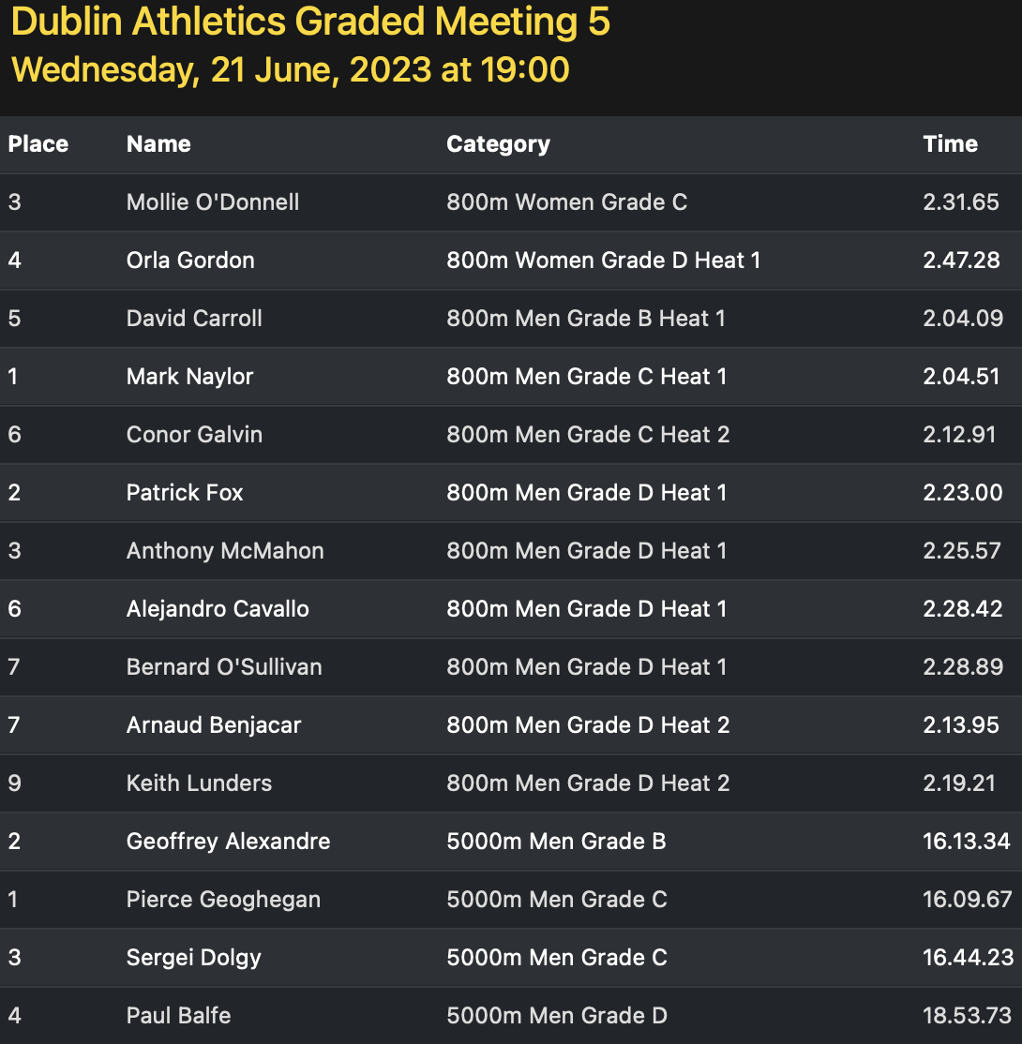

Slide 27
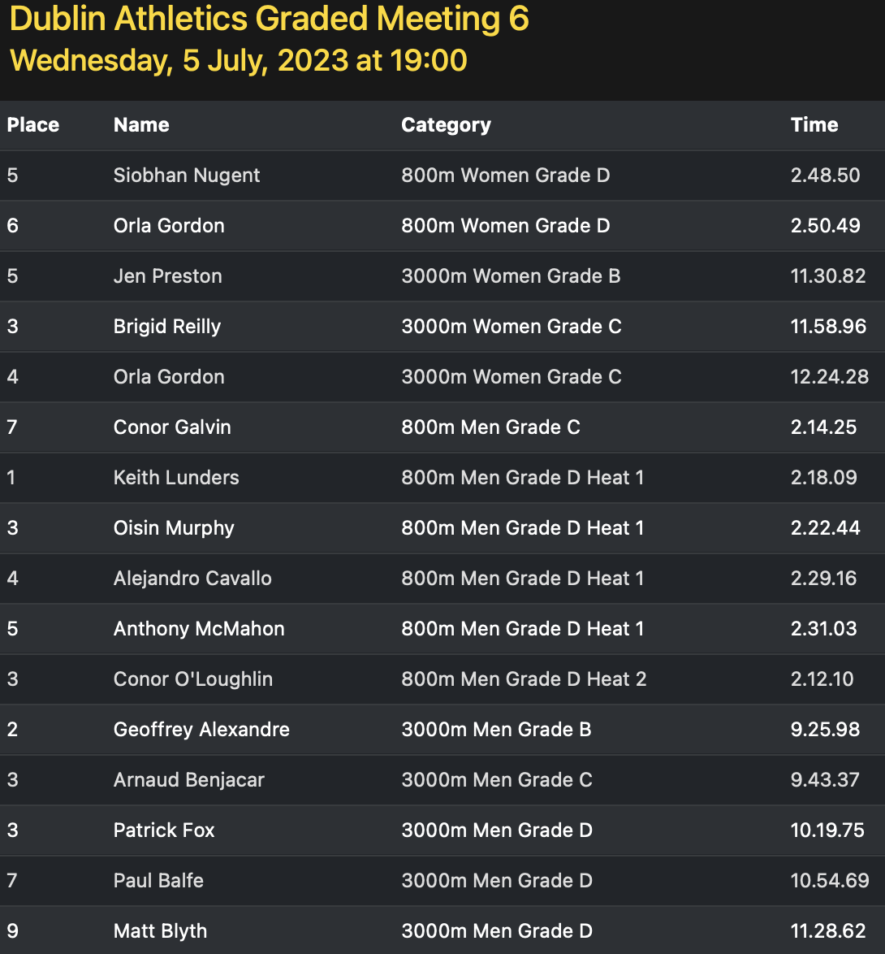

Slide 28
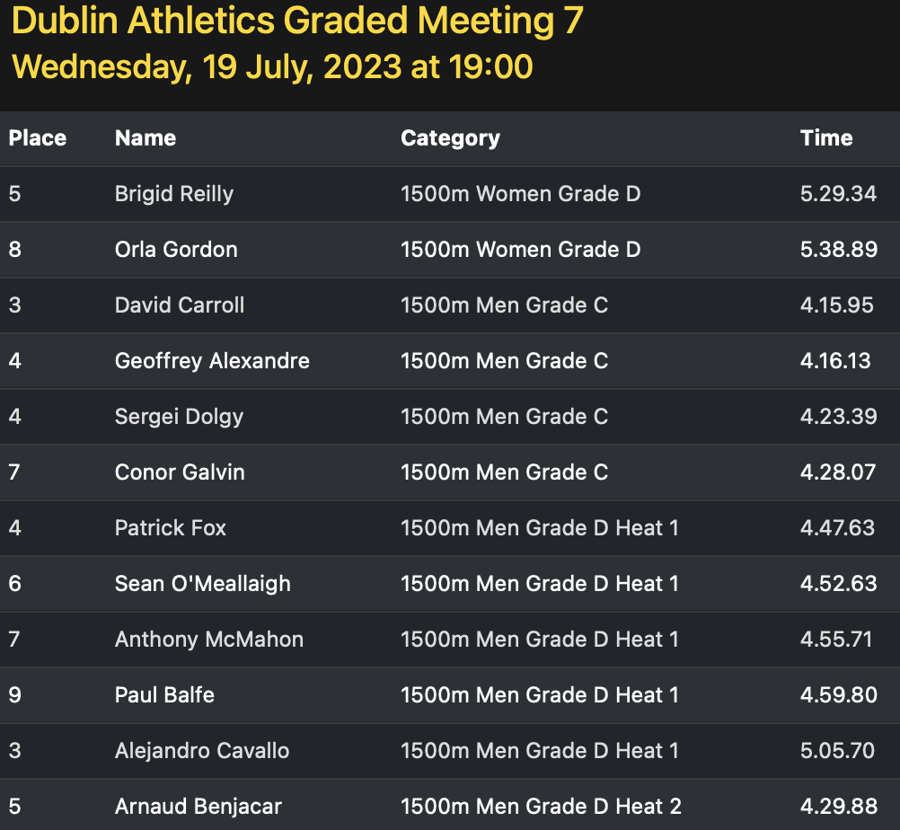

Slide 29
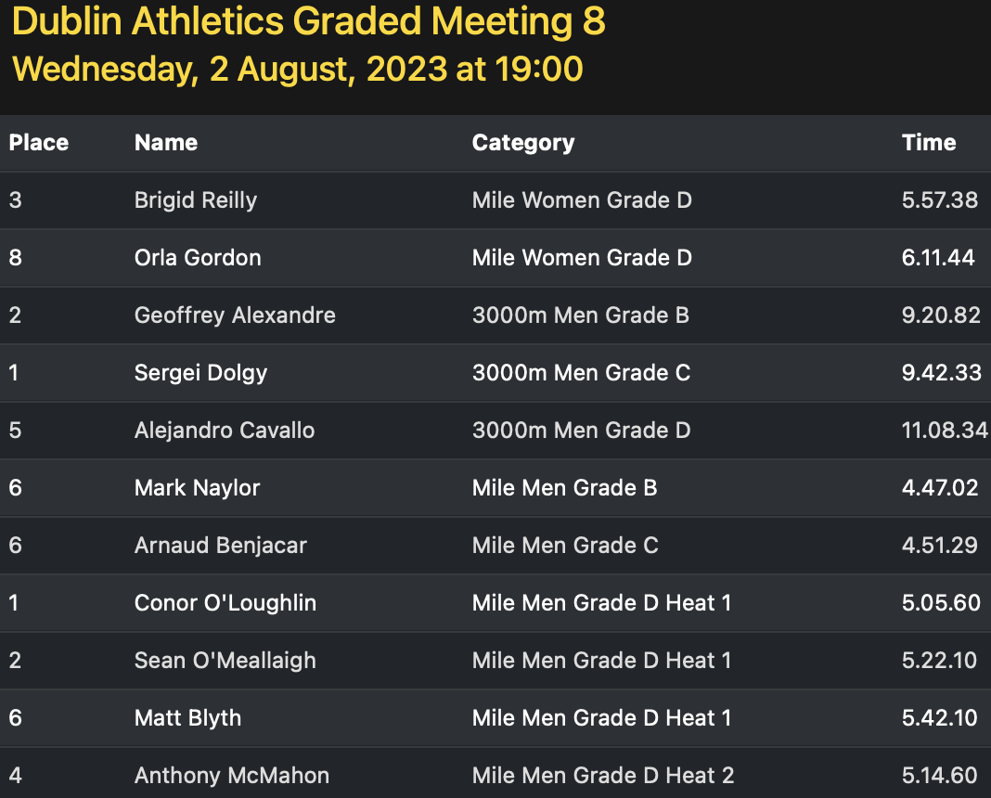

Slide 30
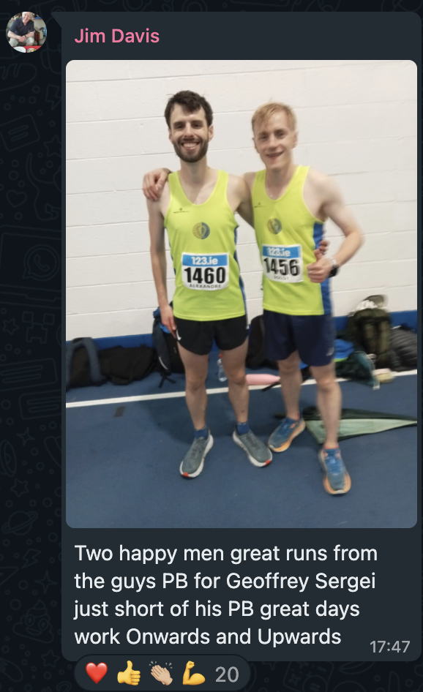
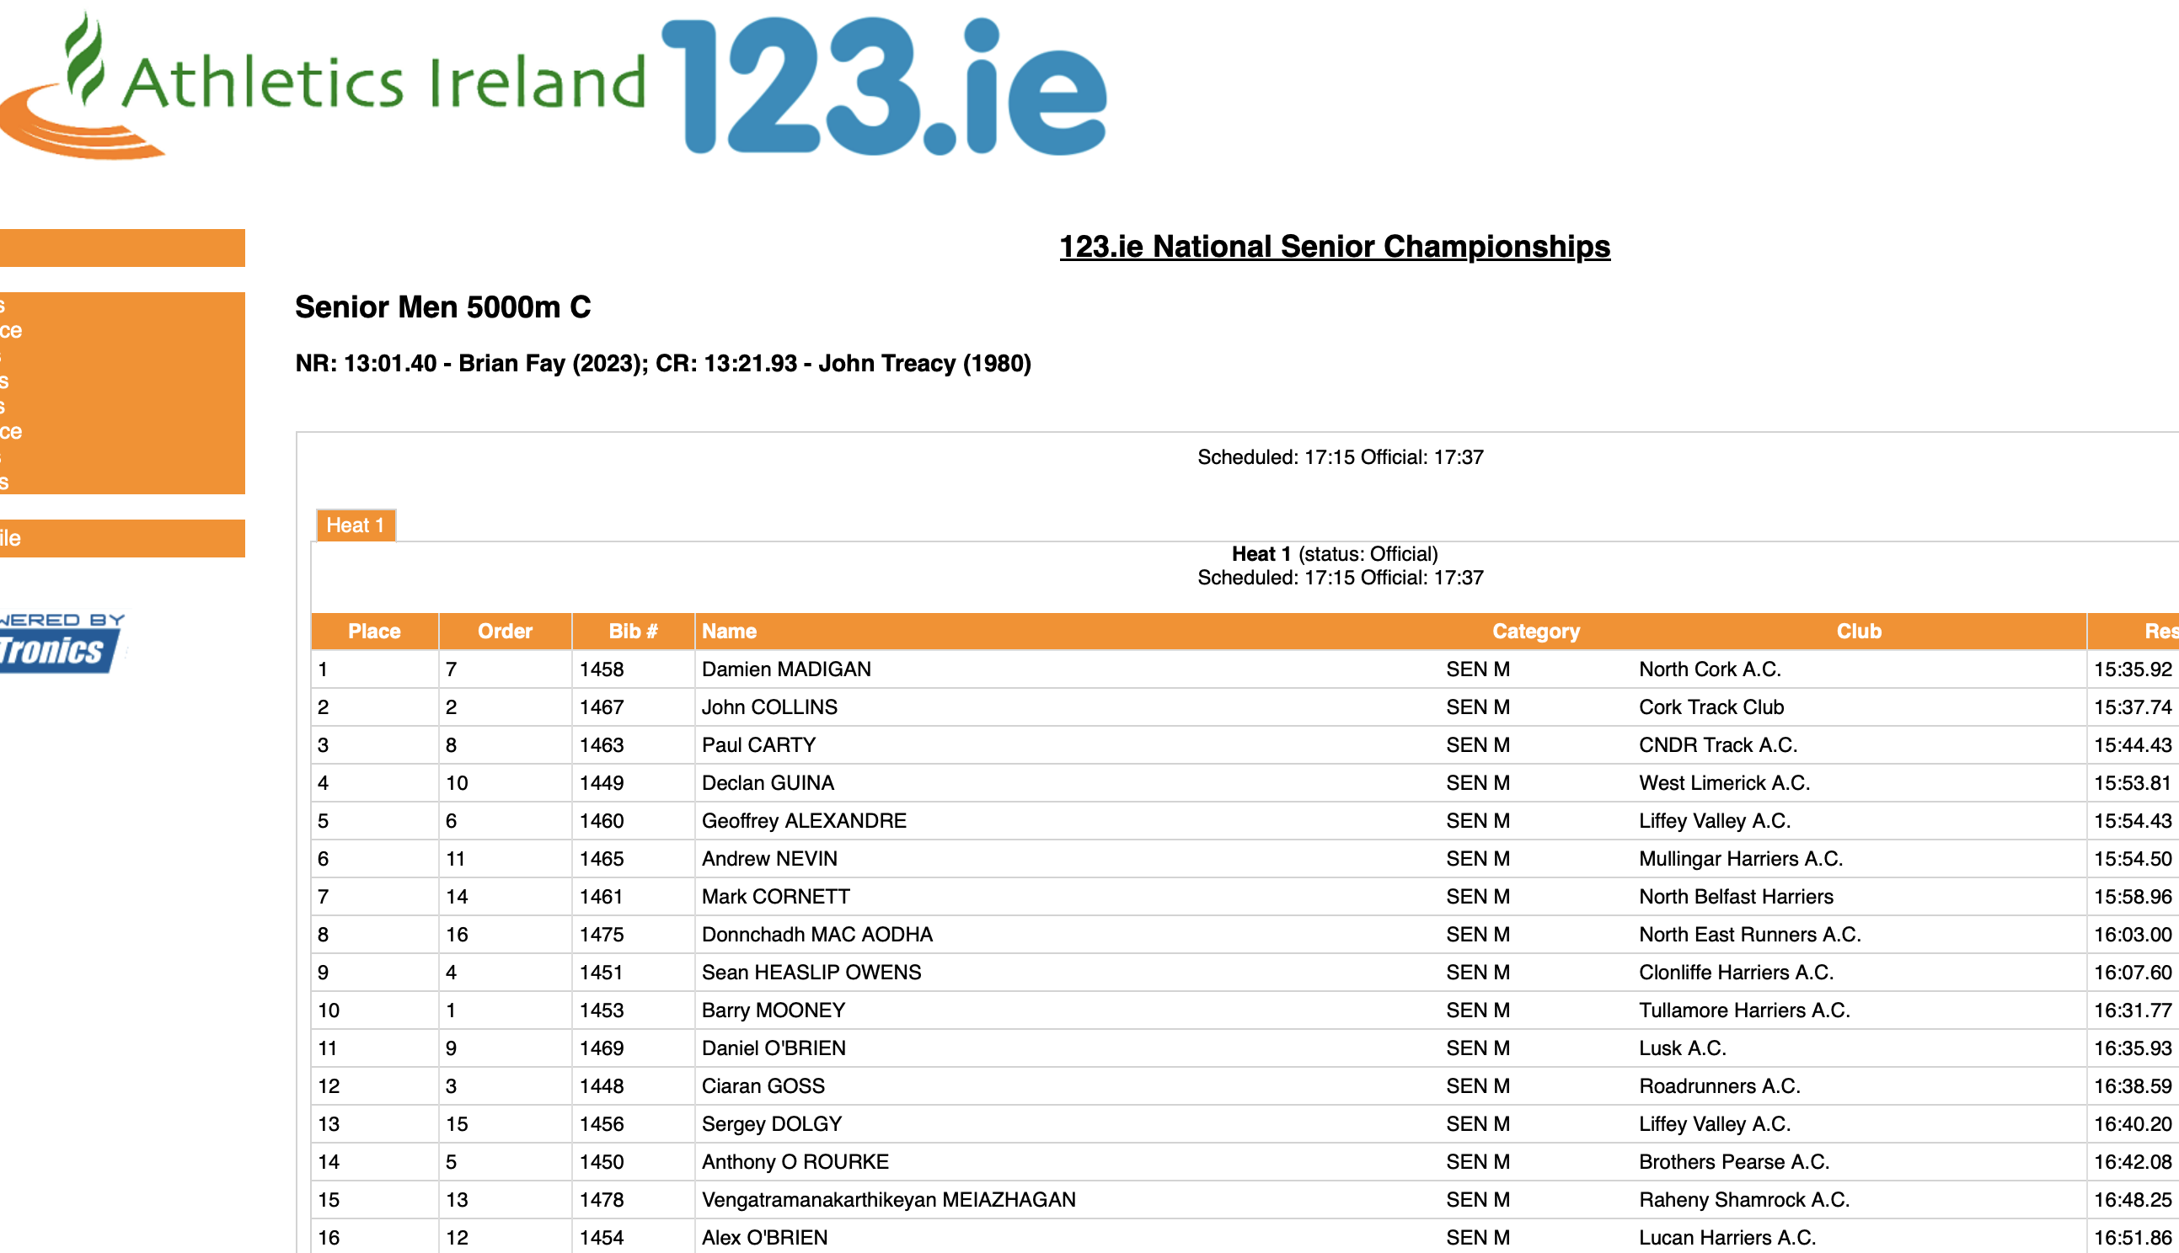
2022/2023 Season Review
Notes:
ID=dd91c577-f997-49fe-a5eb-611d59b20eb8 Recipe=crop Type=Foreground Variant=0 FamilyID=ClassicFrameGoudy_Zero

Slide 31
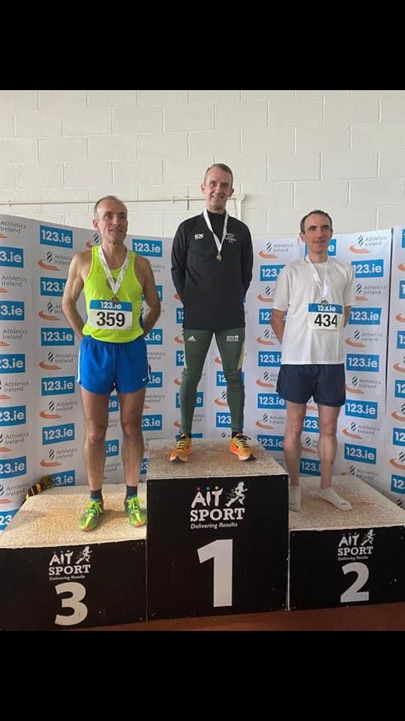
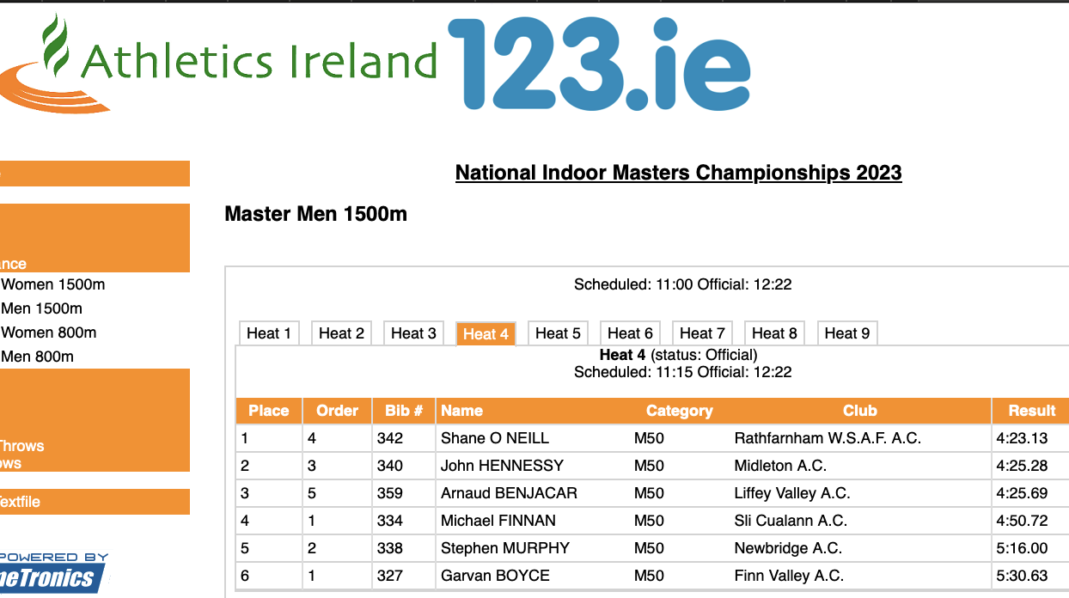
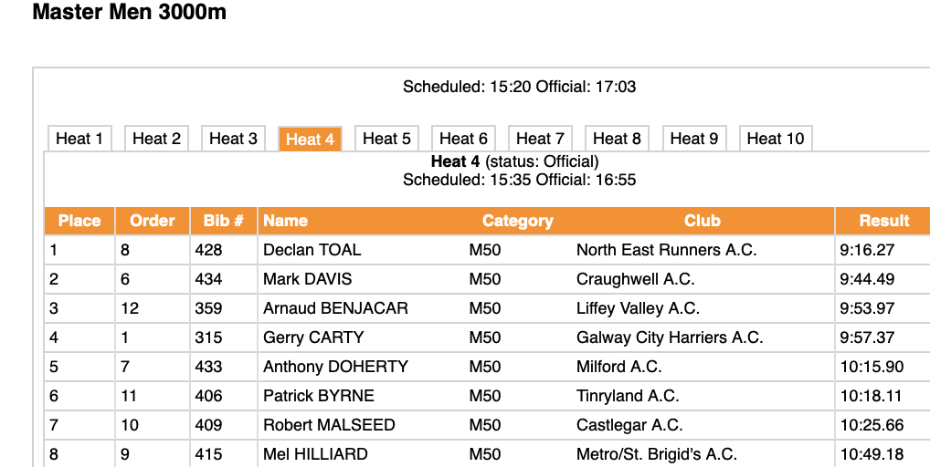
2022/2023 Season Review
Notes:
ID=dd91c577-f997-49fe-a5eb-611d59b20eb8 Recipe=crop Type=Foreground Variant=0 FamilyID=ClassicFrameGoudy_Zero

Slide 32
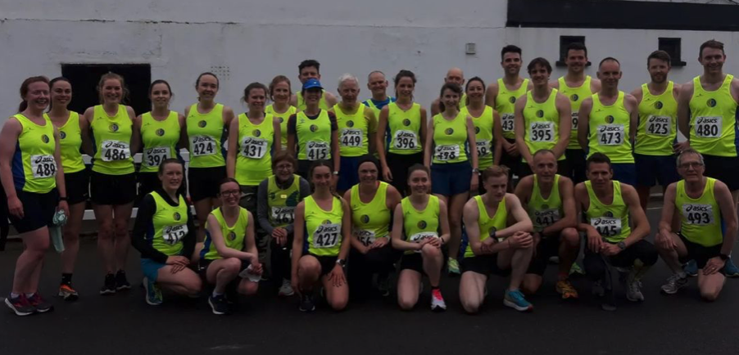
ROAD RACES
2022/2023 Season Review

Slide 33
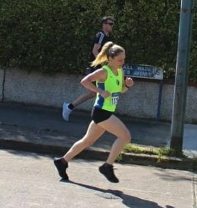
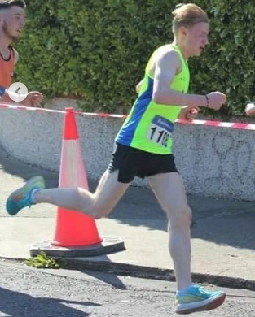
ROAD SUMMARY
56 Athletes took part across 10 championship races
Championship Races
National 7
Leinster 1
Dublin 2
Team Medals 🥇🥈🥈🥉🥉🥈
Individual Medals🥇🥈🥇🥈🥇🥈🥈🥈🥈🥈🥉🥇🥈🥈🥉🥉🥇🥉
13 Other Club Races participated in

Slide 34
ROAD SUMMARY
56 Athletes took part across 10 championship races
Championship Races
National 7
Leinster 1
Dublin 2
Team Medals 🥇🥈🥈🥉🥉🥈
Individual Medals🥇🥈🥇🥈🥇🥈🥈🥈🥈🥈🥉🥇🥈🥈🥉🥉🥇🥉
13 Other Club Races participated in

Slide 35
ROAD RACES
January
23rd Ballyroan AC 10 Mile
April
3rd Paris Marathon
May
15th National 5k
12th National 5 mile
June
July
24th Dublin Novice 5k
September
10th National 10k
12th LVAC 2 Mile
24th National Road Relays
30th Leinster Inter & Master
August
20th Dublin 10 Mile
24th Celbridge AC 5k
27th Tullamore Half Marathon
10th National Half Marathon
18th LVAC 5k Road
25th Berlin Marathon
25th Rathfarnam 5k
October
2nd Quebec 10k
18th LVAC 10k Road
March
27th LVAC Avondale Cup

Slide 36
5k
Date | Race Name | Athlete | Time
25-Aug | Celbridge AC 5k | Mark Naylor | 16.35
15-May | National Road 5k | Geoffrey Alexandre | 16.38
03-Jun | Bohermeen 5k | Arnaud Benjacar | 16.45
15-May | National Road 5k | Arnaud Benjacar | 16.57
24-Jul | National Novice 5k | Sergei Dolgy | 16.57
24-Jul | National Novice 5k | Geoffrey Alexandre | 17.00
15-May | National Road 5k | Sergei Dolgy | 17.17
15-May | National Road 5k | Paul Balfe | 17.50
25-Aug | Celbridge AC 5k | Keith Lunders | 18.06
15-May | National Road 5k | Tom O'Connor | 18.13
15-May | National Road 5k | Keith Lunders | 18.44
24-Jul | National Novice 5k | Keith Lunders | 18.45
Date | Race Name | Athlete | Time
15-May | National Road 5k | Declan Connor | 19.02
15-May | National Road 5k | Philip Williams | 19.12
24-Jul | National Novice 5k | Peter Bowe | 19.43
15-May | National Road 5k | Rachel Murphy | 20.07
15-May | National Road 5k | Kevin McDonnell | 20.19
15-May | National Road 5k | Brigid Long | 20.37
15-May | National Road 5k | Siobhán Nugent | 20.50
14-Nov | Dublin Novice 5k | Siobhán Nugent | 21.18
24-Jul | National Novice 5k | Siobhán Nugent | 21.36
25-Sep | Rathfarnam | Paddy Reilly | 22.37
25-Sep | Rathfarnam | Úna Reilly | 23.35
25-Sep | Rathfarnam | Pat Collins | 23.52

Slide 37
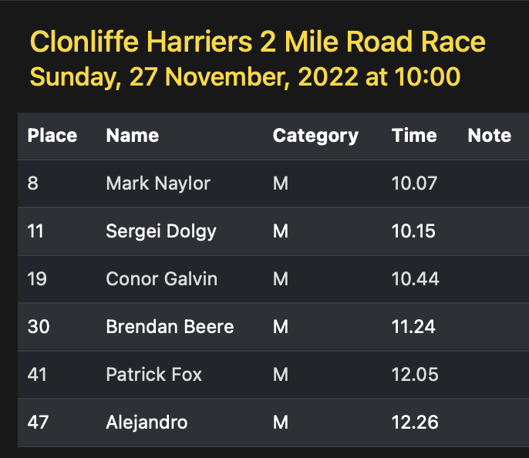

Slide 38
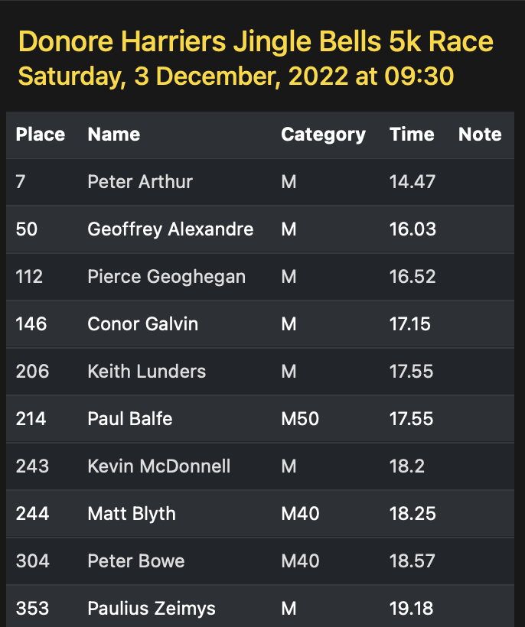

Slide 39
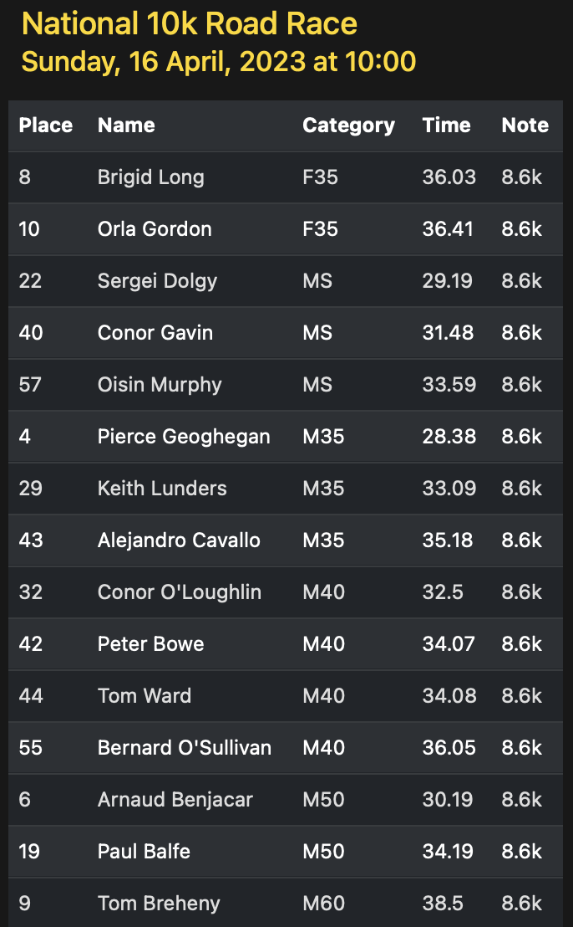

Slide 40
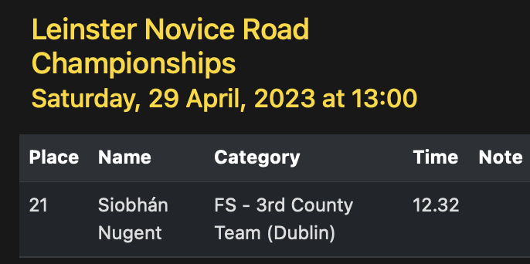

Slide 41
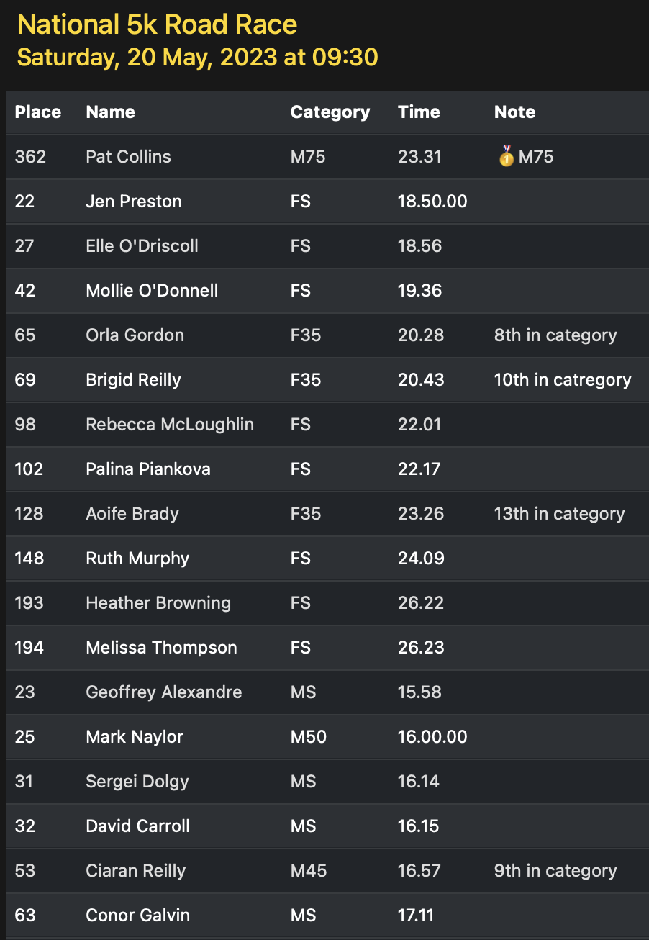

Slide 42
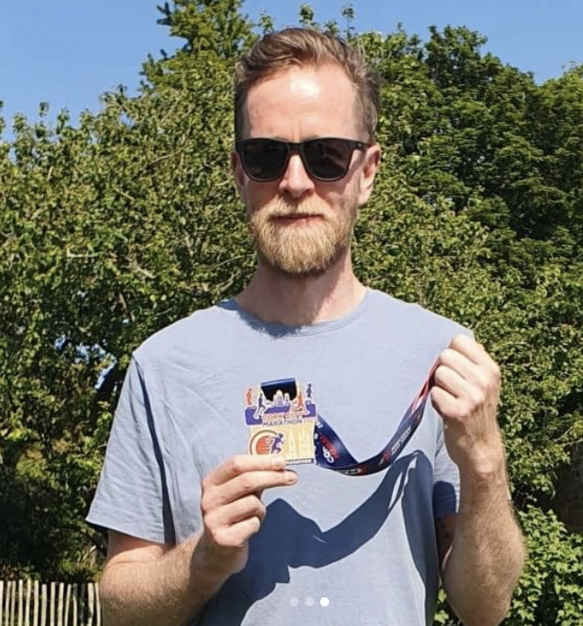
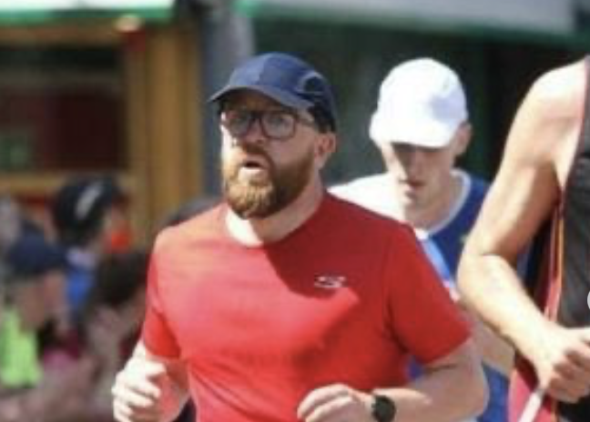
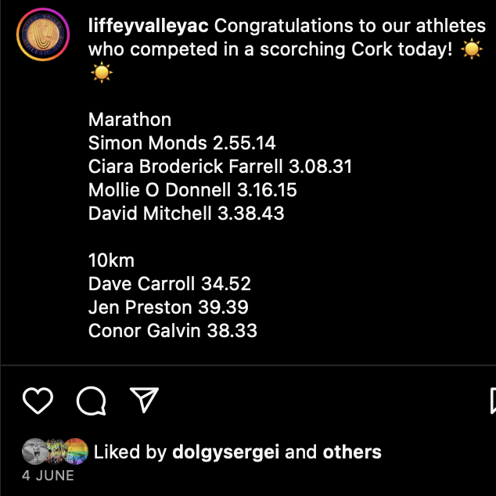
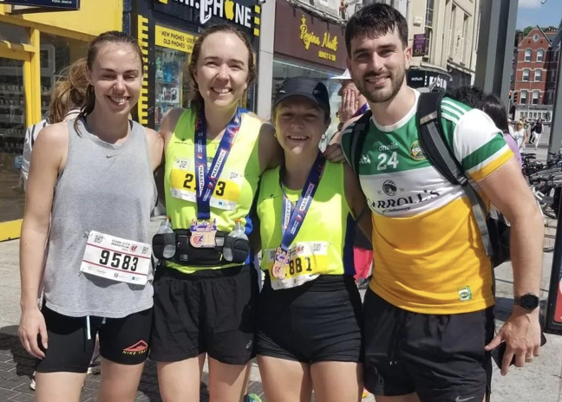

Slide 43
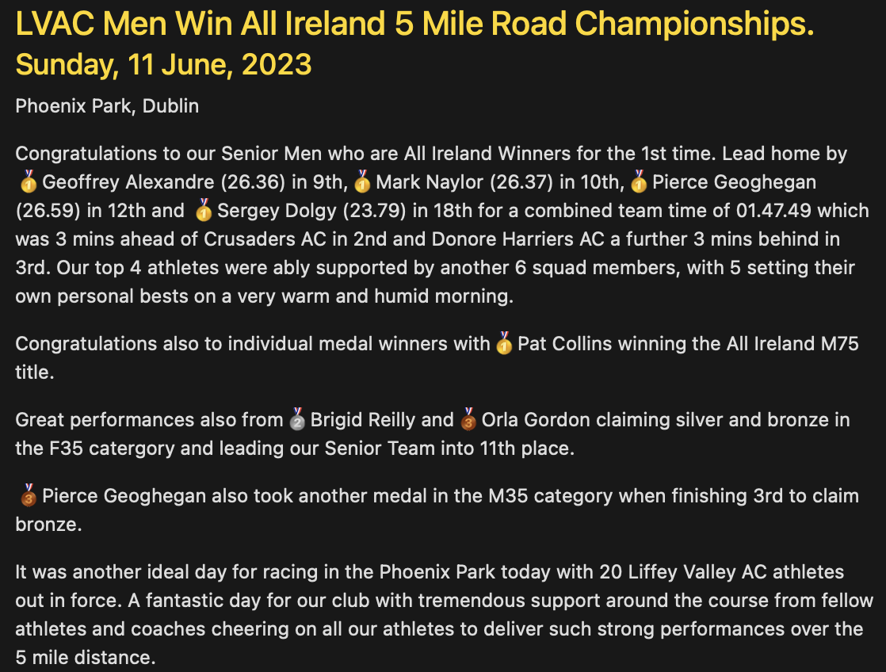
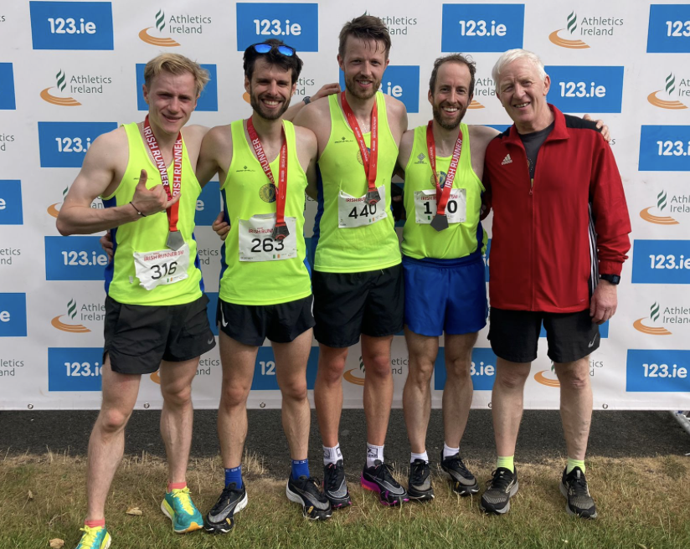
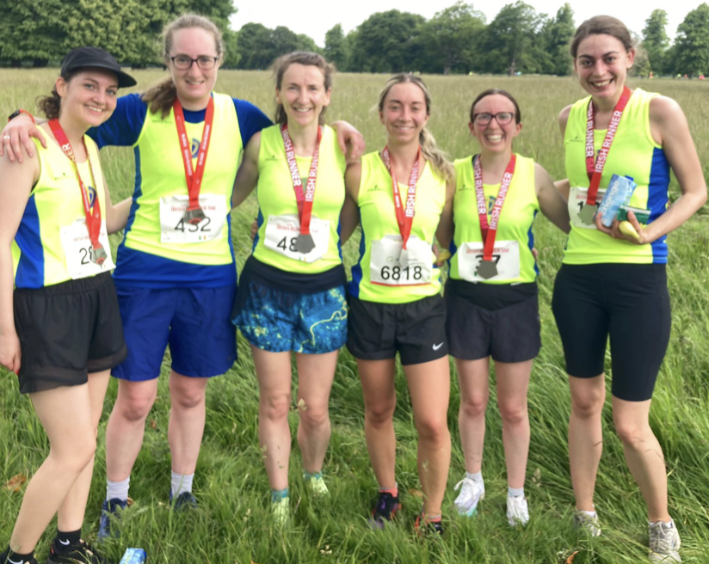

Slide 44
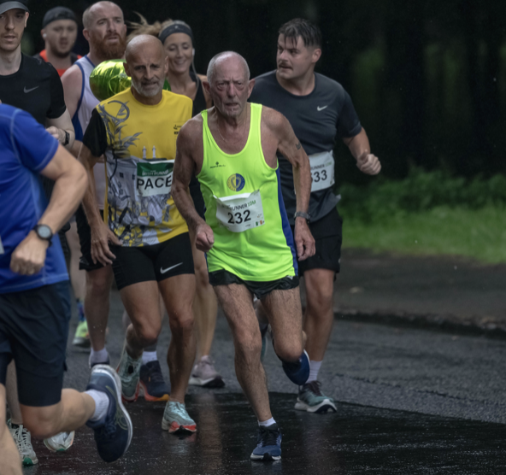
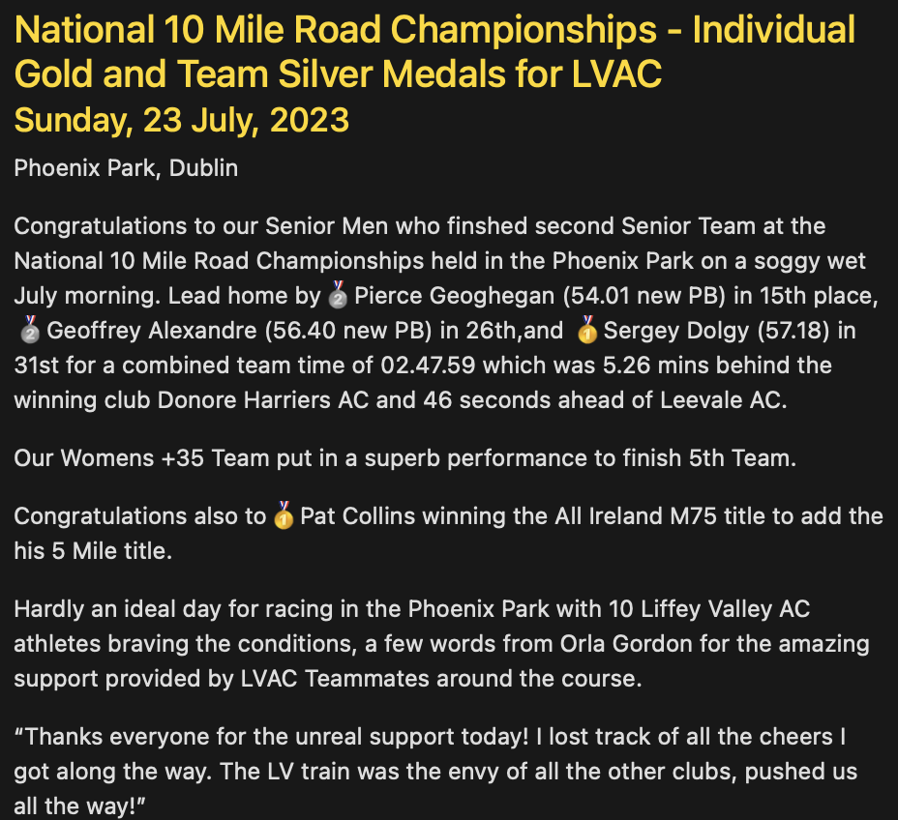
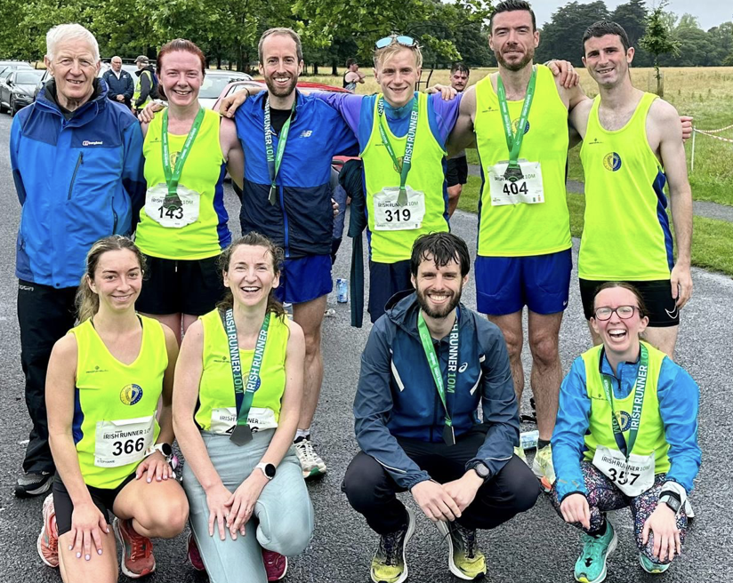

Slide 45





Slide 46



Slide 47



Slide 48



Slide 49


Slide 50



Slide 51



Slide 52



Slide 53

CLUB CHAMPIONSHIPS
2021/2022 Season Review

Slide 54






CLUB CHAMPIONSHIPS
 | Cross Country March 13th 2022 | 800m Track June 27th 2022 | 1500m / 3000m Track July 11th 2022 | 5k / 10k Road September 18th 2022
Women | 🥇 Sinéad McDonald 🥈 Mollie O'Donnell 🥉 Siobhan Nugent | 🥇 Mollie O’Donnell 🥈 Sile Muldowney 🥉 Ciara Broderick Farrell | 🥇 Mollie O’Donnell 🥈 Jen Preston 🥉 Sile Muldowney | 🥇 Mollie O’Donnell 🥈 Sile Muldowney 🥉 Ciara Broderick Farrell
Men | 🥇 Geoffrey Alexandre 🥈 Sergei Dolgy 🥉 Tom O’Connor | 🥇 Mark Naylor 🥈 Geoffrey Alexandre 🥉 Sergei Dolgy | 🥇 Mark Naylor 🥈 Sergei Dolgy 🥉 Geoffrey Alexandre | 🥇 Peter Arthur 🥈 Geoffrey Alexandre 🥉 Mark Naylor
2021/2022 Season Review

Slide 55



CLUB TROPHIES
Avondale Cup | Winter League | George Harrison Cup | Myles Cullen Cup
🥇 David Carroll 🥈 Brigid Long 🥉 Jen Preston | 🥇 Joe Cooper 🥈 Sinead McDonald 🥉 John Touhy | 🥇 Siobhán Nugent 🥈 Rebecca McLoughlin 🥉 Mollie O’Donnell | 🥇 Paul Balfe 🥈 Peter Arthur 🥉 David Carroll
2021/2022 Season Review

Slide 56


RACE Results & REPORTS:
https://liffeyvalleyac.com/races/
2021/2022 Season Review

